Slide 1
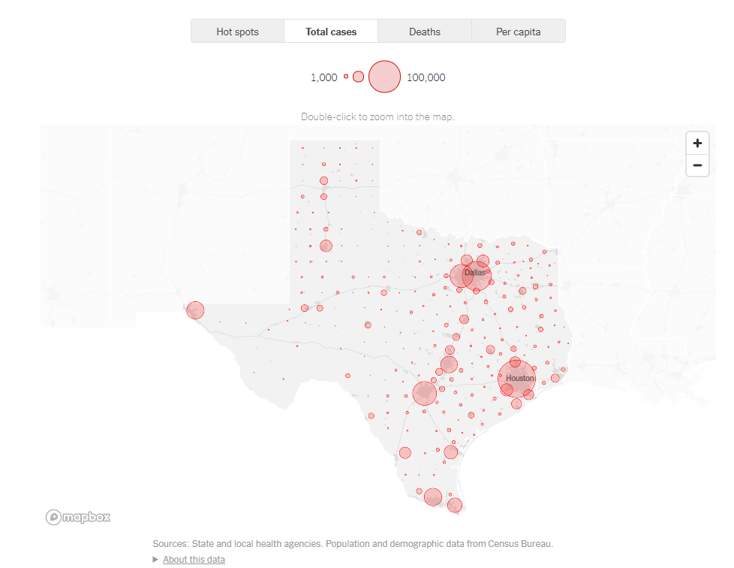

Time Series Forecasting
https://gyazo.com/ad285169543e824ea527765ca4e3469d
Covid-19 Cases & Deaths in Texas by County
Beth Emborsky, Brodie Armstrong, Ellen Rud

Slide 2
Overview
Introduction
App Demo
Data Pre-Processing
Machine Learning Models
Model Comparison
Model Accuracy
Version 2.0

Slide 3

Introduction

Slide 4

Team Members
Beth Emborsky
Back-end & LSTM Model
https://github.com/trackrun82
Brodie Armstrong
Flask Layer & VECM Model
https://github.com/weiliann77
Ellen Rud Gentile
Front End & SARIMA Model
https://github.com/ellenrud84

Slide 5

Sources
Daily Cases & Deaths by County
New York Covid-19 Data Github
https://github.com/nytimes/covid-19-data
Relative Mobility Data
Google US Region Covid-19 Mobility
https://www.google.com/covid19/mobility/
Demographics
Texas Association of Counties
https://imis.county.org/iMIS/CountyInformationProgram/QueriesCIP.aspx

Slide 6

App Demo

Slide 7
Data Pre-Processing

Slide 8
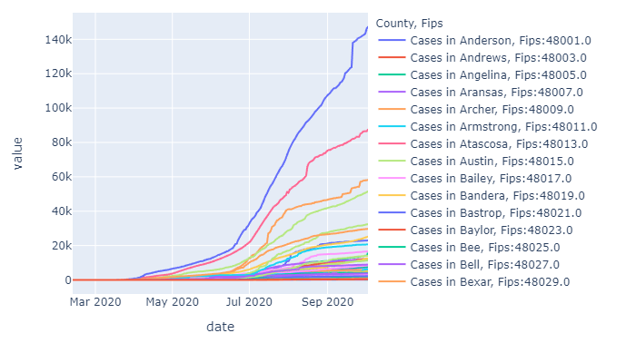
Raw Data
Covid-19 Cases in Texas Counties

Slide 9
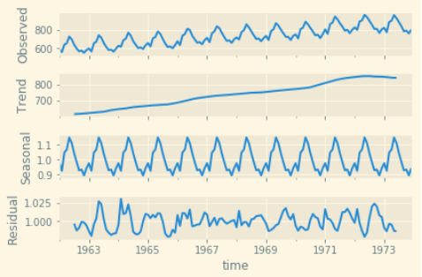
Timeseries ML Requirements
Stationary:
Mean and variance to not change with time
Types of non-stationary events:
Trends, Cycles, Random Walks
Data Tests:
Augmented Dickey Fuller Test (ADF):
Null hypothesis: Data is not stationary
Kwaitkowski-Philips-Schmidt-Shin (KPSS) test:
Null hypothesis: Data is stationary

Slide 10
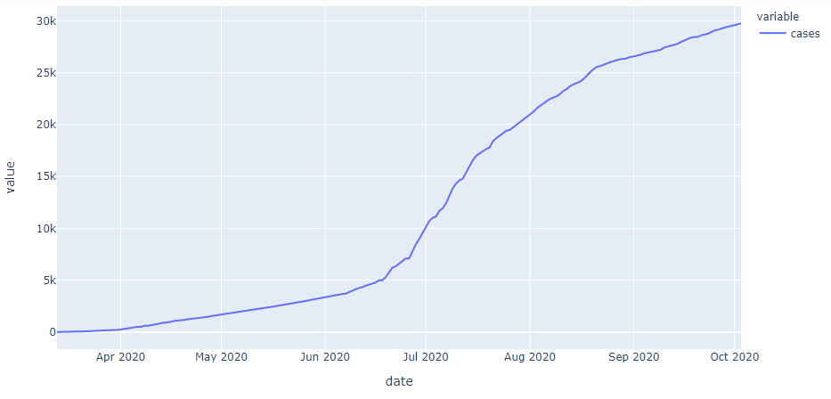
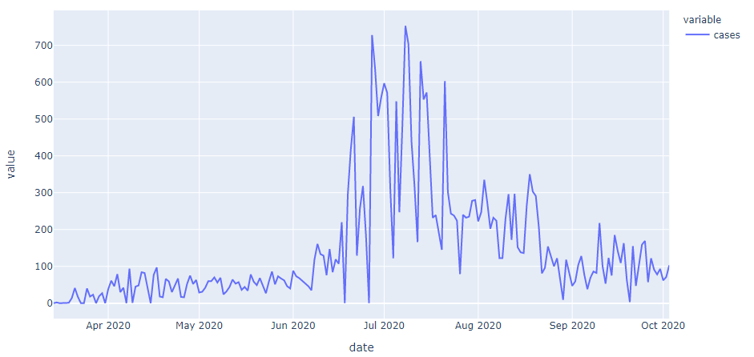
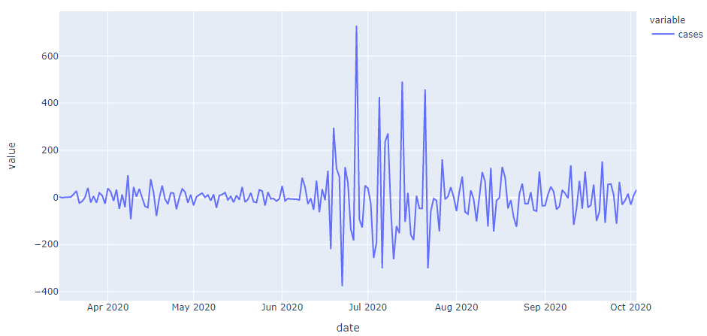
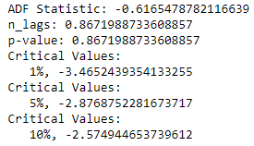
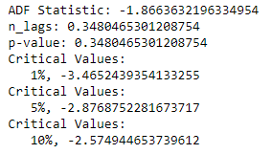
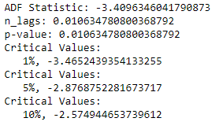
ADF Test on Differencing- Travis County
Notes:
ADF Test - let the algorithm compute the optimal lag number iteratively by setting the autolag='AIC’
Want p-value less than significance level of 0.05 and the ADF statistic lower than the critical values to be able to reject the null hypothesis
If so the time series is stationary

Slide 11
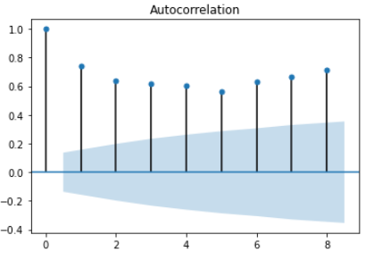
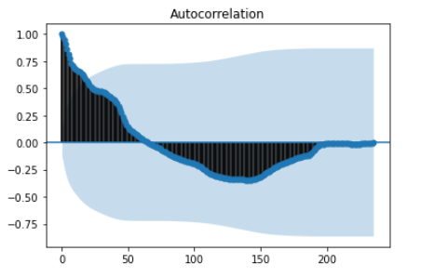
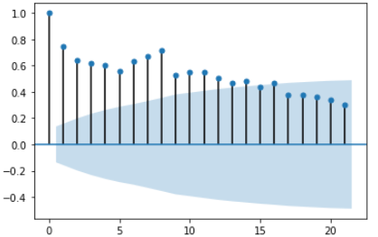
Autocorrelation Plots
Autocorrelation:
“Correlation between the elements of a series and others from the same series separated from them by a given interval.”
-Oxford Dictionaries

Slide 12
Machine Learning

Slide 13
Time Series Models Used
VECM
LSTM
SARIMA

Slide 14


VECM Model
Vector Error Correction Model (VECM)
Used on time series where they have an underlying stochastic trend
Data with TREND
Data with SEASONALITY

Slide 15
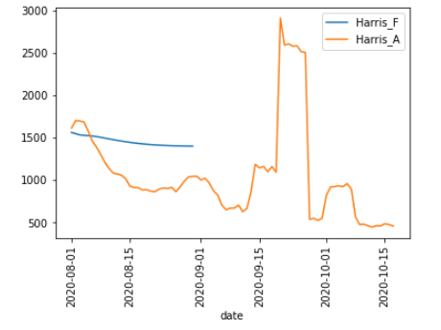
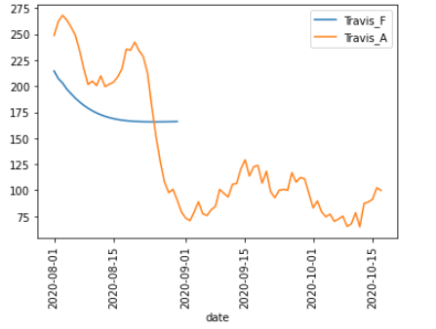
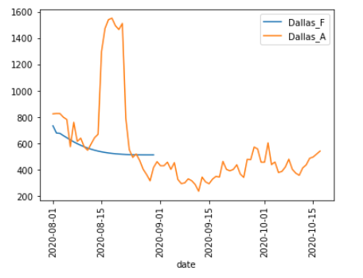
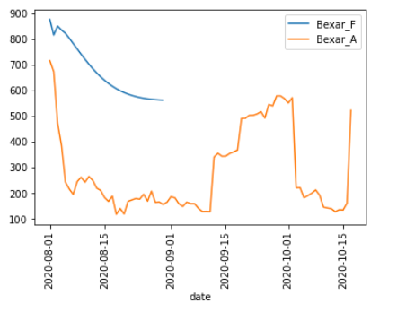
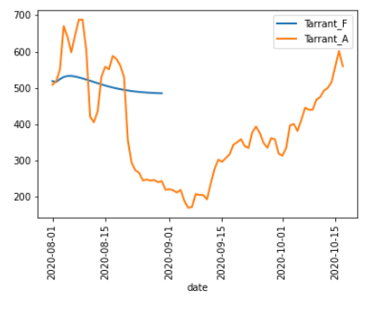
Cases Fit VECM – Cases per Day 30 Day Forecast
VECM Model

Slide 16
SARIMA Model
Seasonal Autoregressive Integrated Moving Average (SARIMA)
Univariate time series forecasting
Data with TREND
Data with SEASONALITY
Notes:
The SARIMA model is built off of the ARIMA model
ARIMA stands for Autoregressive Integrated Moving Average
Autoregressive =
Moving Average elements=
Hyperparameter=
Integrated refers to the differencing, which allows this method to handle data with a trend.
ARIMA expects that data is either not seasonal or has been seasonally adjusted.
SARIMA model is an extension of ARIMA allows input data to contain seasonality and trends, so substantially less pre-processing is required because the model itself takes care of that.
It contains three hyperparameters to specify the Autoregression (AR), differencing (I) and moving average (MA) for the seasonal components of the series as well as an additional parameter for the period of seasonality.

Slide 17
SARIMA Elements
SARIMA(p, d, q)(P, D, Q)m
Trend Elements:
p: Trend autoregression order
d: Trend difference order
q: Moving average order
Seasonal Elements:
P: Seasonal autoregressive order
D: Seasonal difference order
Q: Seasonal moving average order
m: The number of time steps for a single seasonal period (influences P, D,Q)
Notes:
There is also a SARIMAX model which can include multiple other endogenous variables.
All these parameters can be autotuned with a module from the pmdarima library called auto_arima.

Slide 18
LSTM Model
Long short-term Memory (LSTM)
Special kind of Recurrent Neural Network
Has feedback as well as feedforward connections
Univariate time series forecasting
Data with TREND
Data with SEASONALITY
CNN layer added for robustness
Notes:
As gap grows between variables, RNNs become unable to learn to connect the information
LSTM are special kind of RNN because they are capable of learning long-term dependencies
LSTM’s ability to forget, remember and update the information pushes it one step ahead of RNN
CNN (convolutional neural network) – can be very effective at learning features from one-dimensional sequence data

Slide 19
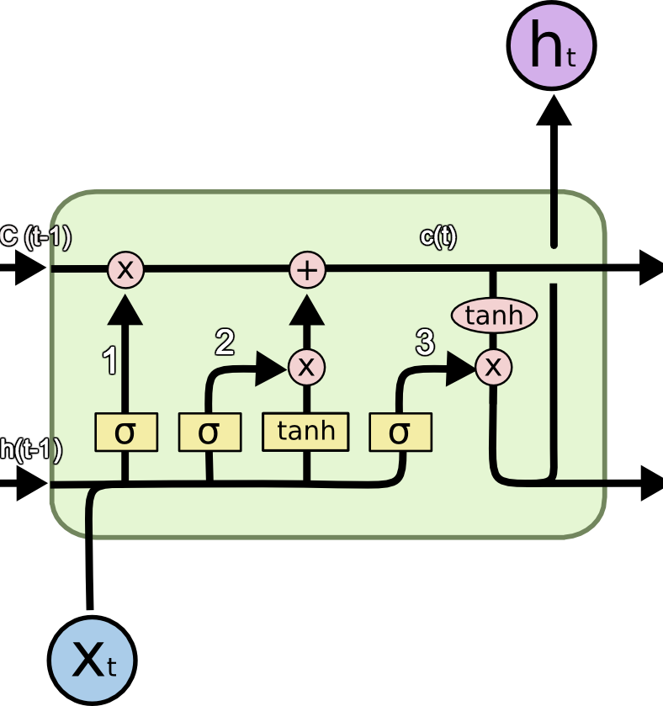
LSTM Elements
X(t): Current input
X: Scaling of information
+: Adding information
σ: Sigmoid layer
tanh: tanh layer
h(t-1): Output of last LSTM unit
c(t-1): Memory from last LSTM unit
c(t): New updated memory
h(t): Current output
The repeating module in an LSTM contains four interacting layers
http://colah.github.io/posts/2015-08-Understanding-LSTMs/
Notes:
In standard RNNs, the repeating module will have a very simple structure, such as a single tanh layer
LSTMs also have this chain like structure, but the repeating module has a different structure. Instead of having a single neural network layer, there are four, interacting in a very special way.
To overcome the vanishing gradient problem, we need a function whose second derivative can sustain for a long range before going to zero. tanh is a suitable function with the above property.
As Sigmoid can output 0 or 1, it can be used to forget or remember the information.
Input sequences are split into subsequences that can be processed by the CNN
The CNN can interpret each subsequence of two time steps and provide a time series of interpretations of the subsequences to the LSTM model to process as input
CNN model first has a convolutional layer for reading across the subsequence
Convolution layer is followed by a max pooling layer that distills the filter maps down to 1/2 of their size that includes the most salient features
These structures are then flattened down to a single one-dimensional vector to be used as a single input time step to the LSTM layer

Slide 20
Model Comparison

Slide 21
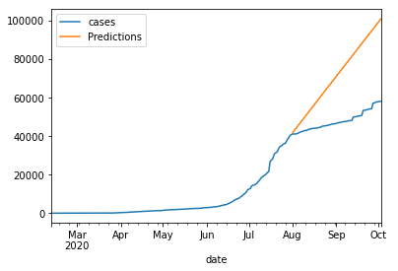
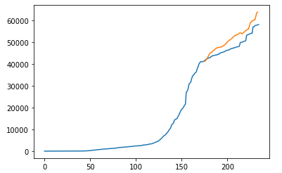
Cases Fit Comparison – Bexar County
SARIMA Model
LSTM Model
Notes:
Basic model set up’s:
SARIMA model used auto_arima to find ideal parameters
LSTM model
1. Data differenced
2. Data was transformed to be supervised learning - the algorithm learns on a labeled dataset, providing an answer key that the algorithm can use to evaluate its accuracy on training data – used lag of +1
3. Data split into train/test
4. Data was scaled to -1 to 1 to mimic the tanh layer
5. Data passed into split_sequence prior to passing into be fit
Train/Test set up:
Initially tested a few counties
Train/Test split can not be random due to being timeseries
Chose cutoff of 7/31 for train set
Test set was 8/1 – 10/3 when we initially pulled data
Model runs:
Initially tested a few counties
After looking at a few counties and adjusting some parameters – ran loop through all data for both cases and deaths to train both models then predict over the test interval
Any counties that had 0 cases at 7/31 were taken out of loop ~ 4 counties
Same with 0 death at 7/31 ~ 50 counties taken out
Also able to train SARIMA model on full data and use that for 90 day forecasting – this data is shown in the app
The case and death data from 10/3 – 10/19 was also downloaded and added to the database to compare these forecasts to actual date

Slide 22
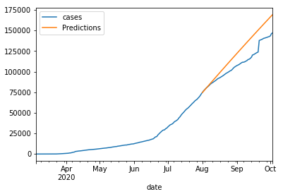
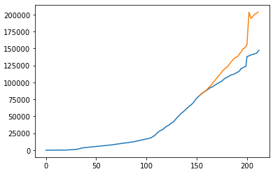
Cases Fit Comparison – Harris County
SARIMA Model
LSTM Model
Notes:
Test data fitted to trained model and compared to raw data

Slide 23
Model Accuracy

Slide 24
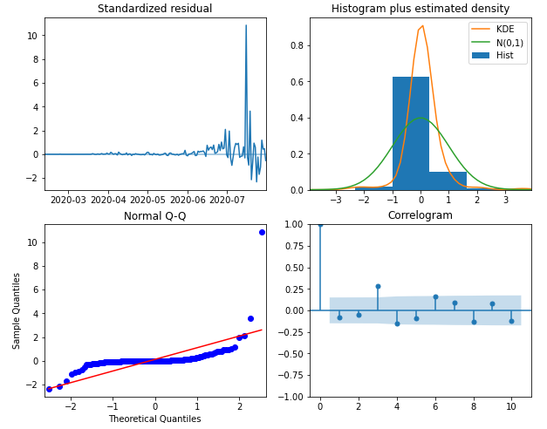
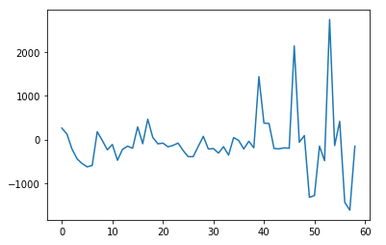
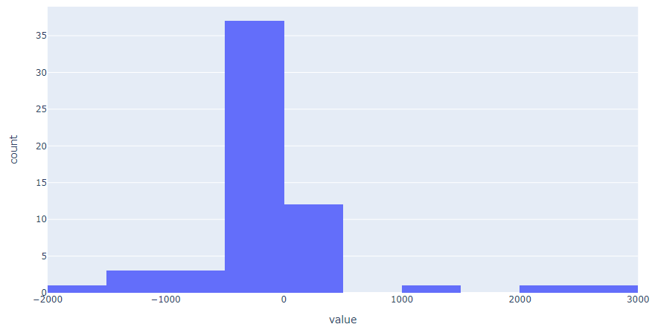
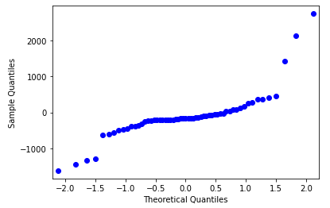
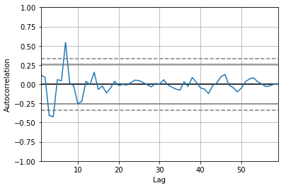
Cases Residual Comparison – Bexar County
SARIMA Model
LSTM Model
Notes:
residuals - look for trend, seasonal or cyclic structure
Large skews in histogram and/or outliers may suggest the opportunity for performing a transform to the data prior to modeling, such as taking the log or square root
Residuals were calculated and stored in database along w/ RMSE’s
histogram plot - A large skew may suggest the opportunity for performing a transform to the data prior to modeling, such as taking the log or square root
Residual Q-Q Plot - look for outliers
Residual Autocorrelation plot - look for obvious autocorrelations at certain lags
Bexar County – FIPS 48029
RMSE of SARIMA – 26936.7332093663
RMSE of LSTM - 674.947763175809

Slide 25
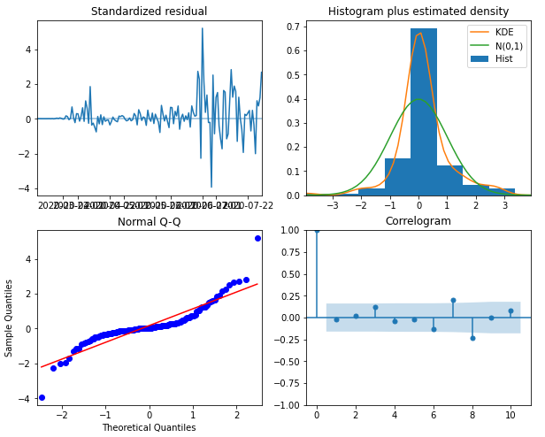
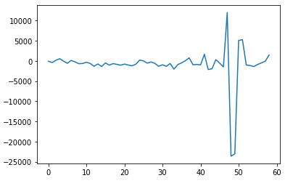
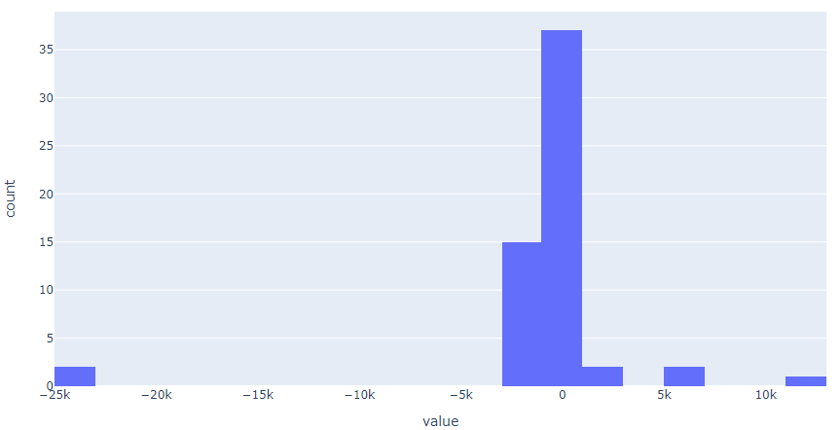
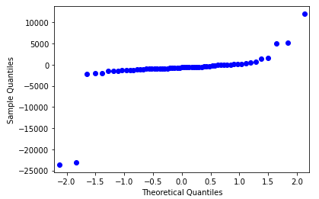
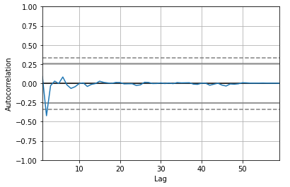
Cases Residual Comparison – Harris County
SARIMA Model
LSTM Model
Notes:
residuals - look for trend, seasonal or cyclic structure
histogram plot - A large skew may suggest the opportunity for performing a transform to the data prior to modeling, such as taking the log or square root
Residual Q-Q Plot - look for outliers
Residual Autocorrelation plot - look for obvious autocorrelations at certain lags

Slide 26
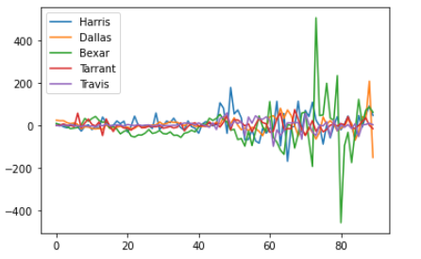
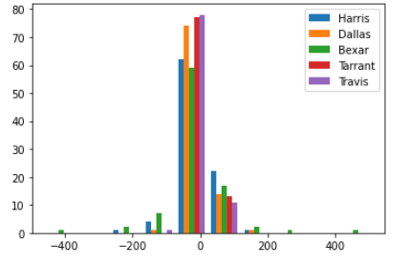
Cases Residual Comparison VECM Model
VECM Model
Notes:
residuals - look for trend, seasonal or cyclic structure
histogram plot - A large skew may suggest the opportunity for performing a transform to the data prior to modeling, such as taking the log or square root

Slide 27
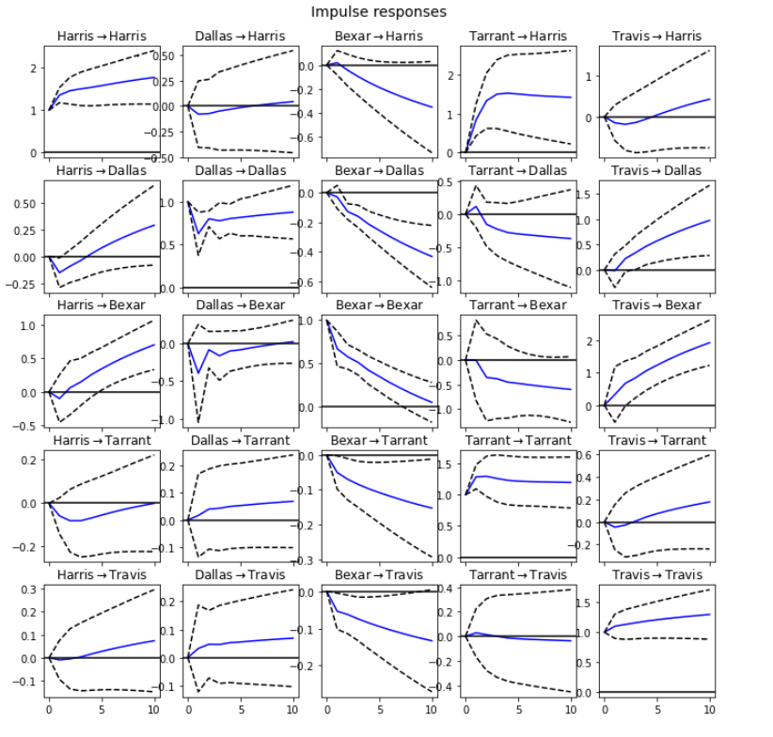
VECM Impulse response
VECM Model

Slide 28
Version 2.0+
Add:
Multivariate models VECM, VARMAX, SARIMAX
Forecasts for all models
“Error cone” on forecasts
MSE & RMSE
County location map
Optimize:
LSTM tuning
Bug Fix:
Responsive plot svg elements
Investigate:
# Daily tests per capita
Per capita cases & deaths
Deaths as % of cases

Slide 29


Pmdarima Autotuning
KPSS & ADF tests to determine d (order of differencing)
Fits p and q to model within ranges of defined start_p, max_p, start_q, max_q
If seasonal option is enabled it also uses Canova-Hansen method to determine the optimal order of seasonal differencing, D and then identifies the optimal P and Q values.
Limitations: you must input m, the period of seasonality.

Slide 30
Data Inconsistencies
Prior to August when a DSHS system upgrade was made several thousands of positive case results had been overlooked or miscoded- meaning that some counties case counts has been artificially low for months and would be artificially high in late Aug-early Sept as omitted cases were added.
Backlogs at labs
Conflicts between county and state data
Policy on what counts as a Covid-19 death.
Backlogs on death certificate processing.
Non-standardized data inputs (electronic reports, faxes, etc.) to DSHS system.
Until Aug 1 DSHS capacity for receipts of electronic reports is 48,000/day. Since then it can handle more than 100,000 electronic reports a day. This resulted in an artificial early august increase in the number of cases.
Every county in Texas has an independent health department. Some of these relies on outdated tech such as faxing results and manually encoding them, which has led to several omissions and later fixes of the data.
“In late July, Texas changed the way it tallies coronavirus deaths. It started basing its counts on death certificates filed with the state, instead of gathering figures from local health department websites, which often rely on reports from hospitals and physicians. The change was intended to make the tallies for all 254 counties consistent and comparable, but it has distorted data for several locations, confusing residents and local officials alike”
“Hidalgo County in the hard-hit Rio Grande Valley said its cumulative death toll was 531; the state’s figure was 254.”
“Hidalgo [county] officials said the discrepancy was probably caused by delays of up to three weeks in issuing death certificates in the county. In a detailed letter on Facebook, they said the state had made the change without consulting them.”
“In one of more than 100 comments posted on Facebook in response to the county’s letter, a Facebook user wrote, “Do you understand that these discrepancies lead us all to think that you are hyping the numbers?”
New York Times 2020/09/13: https://www.nytimes.com/2020/09/13/us/texas-virus-data.html

